Slide 1





Software Engineering For Machine Learning
Presentation By: Bhakta, Tejash | Naidu, Vidhyadhari | Pednekar, Mamta

Slide 2
Authors
Saleema Amershi
Microsoft Research
Redmond, WA USA
samershi@microsoft.com
Andrew Begel
Microsoft Research
Redmond, WA USA
Andrew.begel@microsoft.com
Thomas Zimmermann
Microsoft Research
Redmond, WA USA
tzimmer@microsoft.com
Christina Bird
Microsoft Research
Redmond, WA USA
cbird@microsoft.com
Robert DeLine
Microsoft Research
Redmond, WA USA
rdeline@microsoft.com
Harald Gall
University of Zurich
Zurich, Switzerland
gall@ifi.uzh.ch
Ece Kamar
Microsoft Research
Redmond, WA USA
eckamar@microsoft.com
Nachiappan Nagappan
Microsoft Research
Redmond, WA USA
nachin@microsoft.com
Besmira Nushi
Microsoft Research
Redmond, WA USA
Besmira.nushi@microsoft.com

Slide 3


1. What does the paper offer?
Notes:
Recent advances in machine learning have stimulated widespread interest within the IT sector on integrating AI capabilities into software and services. This goal has forced organizations to evolve their development processes to properly evaluate AI processes. The paper reports on a study that was conducted by observing and interviewing software teams at Microsoft as they develop AI-based applications.

Slide 4
A description of how several Microsoft software engineering teams work cast into a nine-stage workflow for integrating machine learning into application and platform development.
A set of best practices for building applications and platforms relying on machine learning.
A custom machine-learning process maturity model for assessing the progress of software teams towards excellence in building AI applications.
A discussion of three fundamental differences in how software engineering applies to machine-learning–centric components vs. previous application domains.

Slide 5
Software Engineering Process
Feedback-intense Agile methods used to develop software for at least a decade and half
Many teams relied heavily on development triads consisting of a program manager, a developer and a tester.
“The latest trend to hit the software industry is around integrating artificial intelligence (AI) capabilities based on advances in machine learning.”
Notes:
because they needed to be responsive at addressing changing customer needs through faster development cycles.
Program Manager looks after requirement gatherings and scheduling
Developer is for programming and tester for testing.

Slide 6
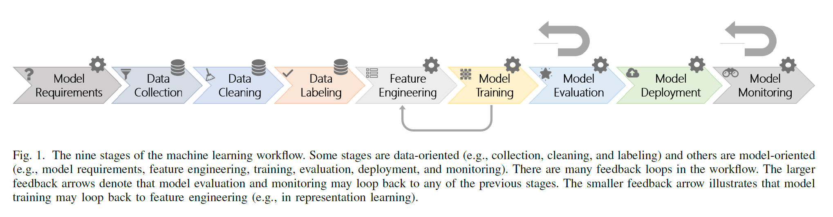
ML Workflow
Notes:
One commonly used machine learning workflow at Microsoft has been depicted in various forms across industry
and research [1], [9], [10], [11]. It has commonalities with prior workflows defined in the context of data science and data
mining, such as TDSP [12] – Team Data Science Process,
KDD [13],
and CRISP-DM [14] – Cross-industry standard process for data mining

Slide 7
Applications built by Microsoft product teams using ML
Bing Search
Cortana Virtual Assistant
Microsoft Translator (real-time translations of text, voice and video)
Cognitive Services
Azure AI platform

Slide 8
Why Software Engineering for ML?
1. Identify various aspects of ML system architecture and requirements
needed for system design.
2. Multiple efforts in industry have been made by building frameworks and environments to support the ML workflow and its experimental nature. However, ongoing research and surveys show that engineers still struggle to operationalize and standardize working processes.
Notes:
Some of these aspects include hidden feedback loops, component entanglement and eroded boundaries, nonmonotonic error propagation, continuous quality states, and mismatches between the real world and evaluation sets.
The goal of this work is to uncover detailed insights on ML-specific best practices used by developers at Microsoft.

Slide 9
Case Study
Interviews
Data Collected
Surveys
> No key stakeholders on this topic of adoption. > Snowball Sampling Strategy > Approached variety of teams for different levels of experience.

Slide 10
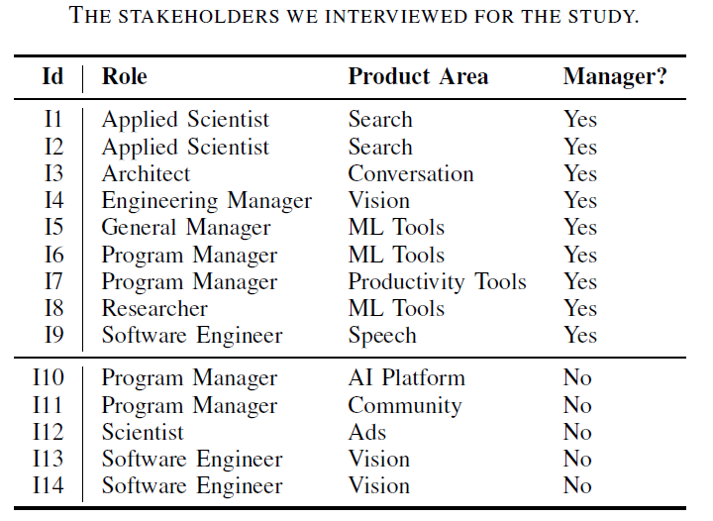
SURVEY: > Open ended questionnaire focused on the existing work practice
> Questionnaire was sent to 4195 members through internal mailing on AI and ML
> 13.6% was the response rate
> Team reviewed the responses through a card sort. > Respondents were from different divisions and different roles.

Slide 11
Applications of AI
> In traditional areas such as Search, Advertising, Machine Translation, Voice and Image Recognition > In the modern areas such as gameplay, healthcare, word processing documents and so on.
Applications of ML
> To build the applications from classification, clustering, dynamic programming, statistics, on natural language processing.
> In Finance and Sales for risk prediction model and forecasting.
> Thus, it was understood that integration of ML was all over the company.

Slide 12
Best practices with Machine Learning In Software Engineering

Slide 13
1. End-to-end pipeline Modeling:
> Noted the importance of automating the 9 stages of ML workflow.
> This could reduce the overhead and facilitate the progress in the field
> Respondents have built pipelines which enables the engineers to try out many permutations of AI algortithms.
2. Data availability, collection, cleaning and management
> The success of the ML-centric projects heavily depends on the data availability, quality and management.
> Reuse the data as much as possible to reduce the duplicated effort.

Slide 14
3. Education and Training
Microsoft hosts:
Yearly Internal Conferences on ML and Data Science
Open Forums for ML and Deep Learning
Mailing Lists and Online Forums
4. Model Debugging and Interpretability
As ML Algorithms become more complex, understanding how and when models fail is an active research area

Slide 15
5. Compliance
-Fairness
-Accountability
-Transparency
-Ethics

Slide 16
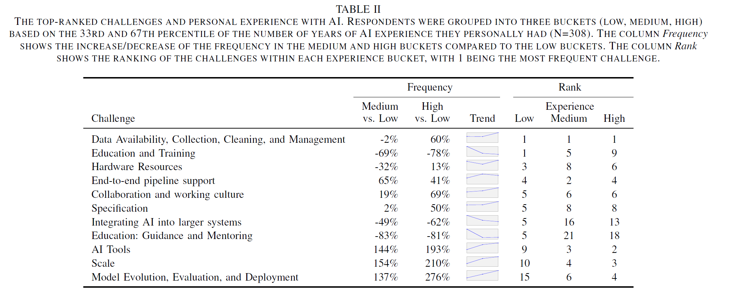
6. Varied Perceptions

Slide 17
Model of ML Process Maturity
Defined Goals
Consistently Implemented
Documented
Automated
Measured and Tracked
Continuously Improved

Slide 18
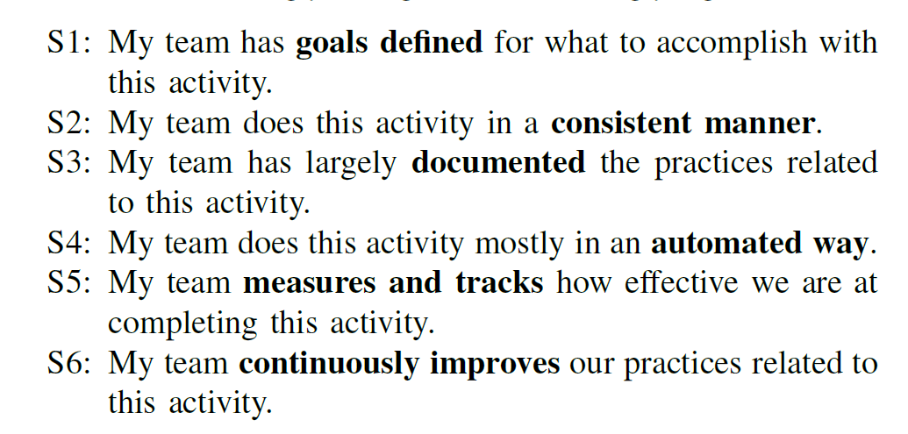
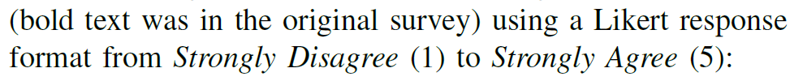
Case Study of Maturity and Effectiveness
Statements S1 to S6
Activity Maturity Index
Activity Effectiveness
Overall Effectiveness

Slide 19
Observations
Data Discovery and Management
Customization and Reuse
ML Modularity

Slide 20
Limitations
Specific to Microsoft teams and team member
Some of the findings depends on models with ML Workflow only
ML process Maturity Model based on Microsoft team member reviews

Slide 21
Conclusion
Learn more about the process and practice changes undertaken by Microsoft teams in recent years.
Best practices to address issues fundamental to a large-scale development and deployment of ML-based application
ML process maturity metric to help teams self-assess
Three aspects of the AI domain that make it fundamentally different from prior application domains

